Slide 1
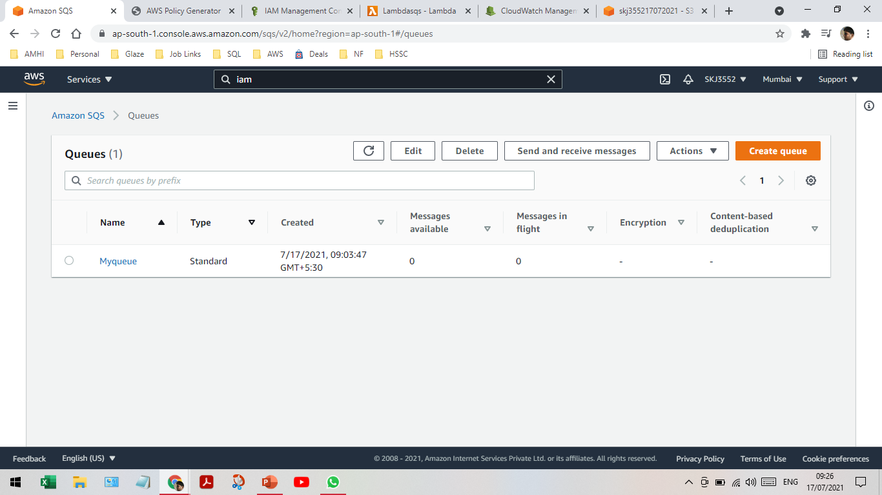
Creating a queue

Slide 2
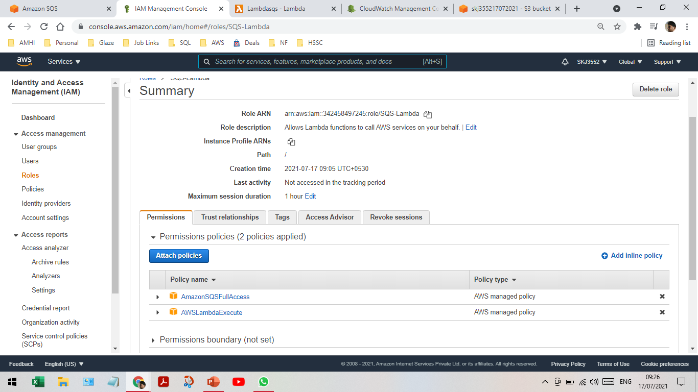
Creating an IAM role

Slide 3
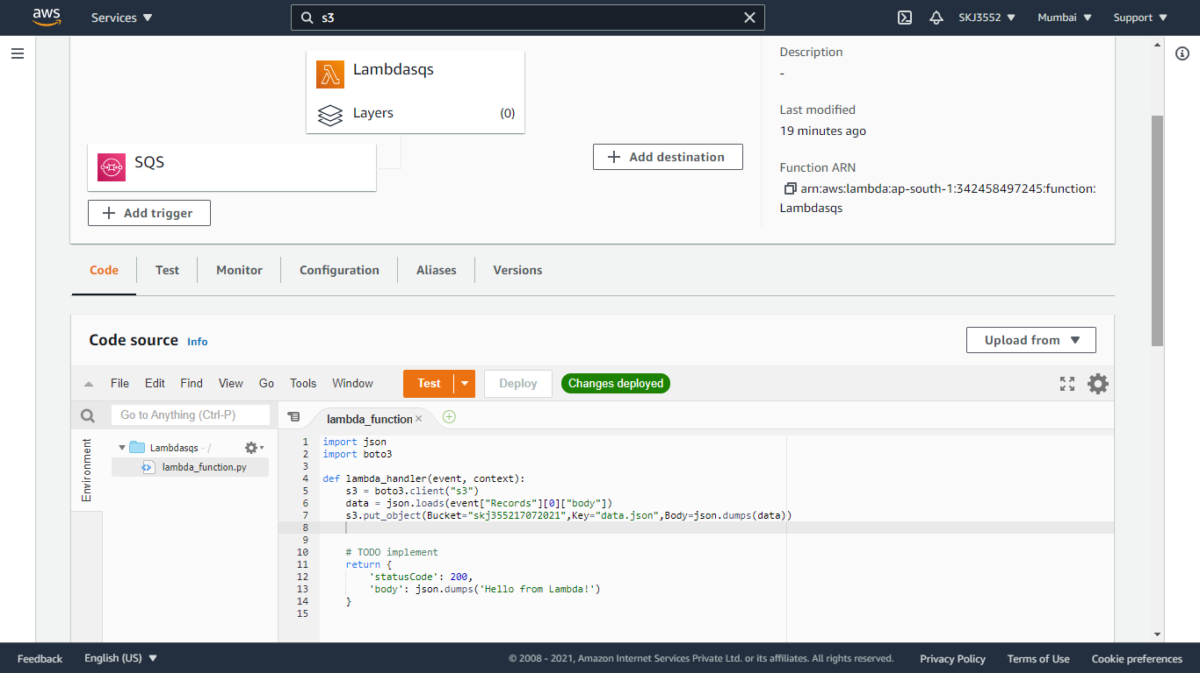
Creating an SQS trigger and JSON code to store message in s3 bucket

Slide 4
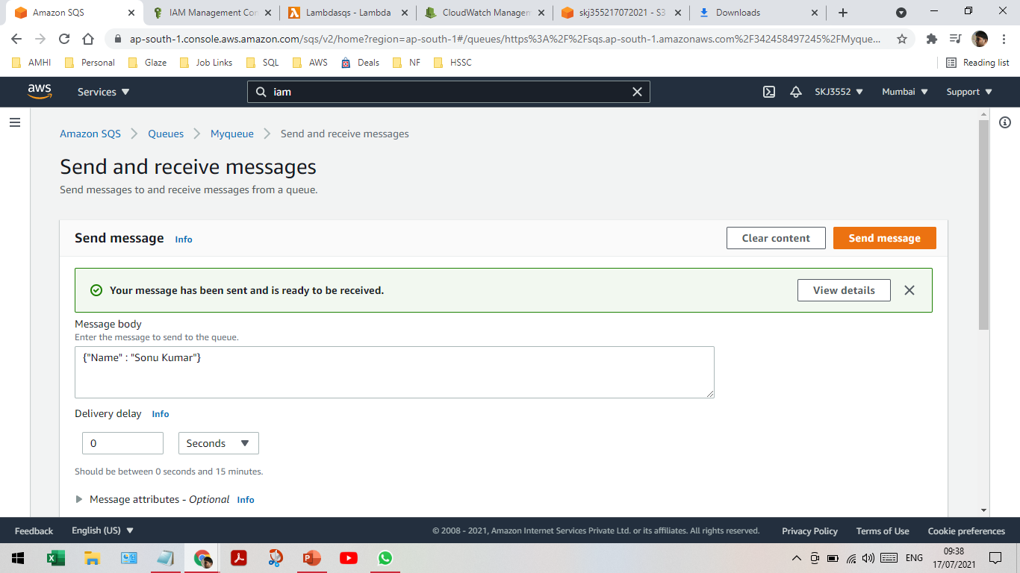
Message triggered

Slide 5
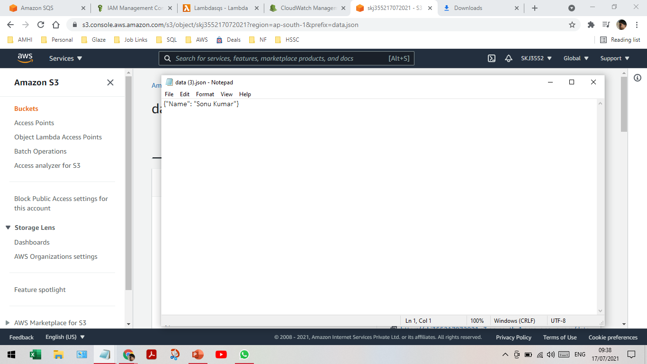
Triggered message downloaded

Slide 6
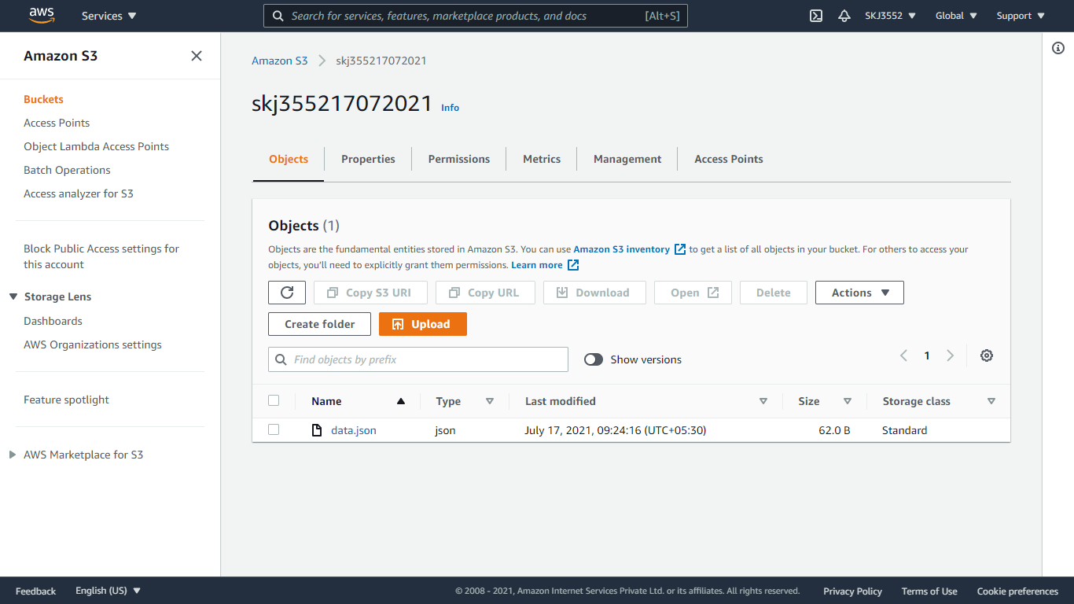
S3 bucket and data stored with versioning enabled

Slide 7
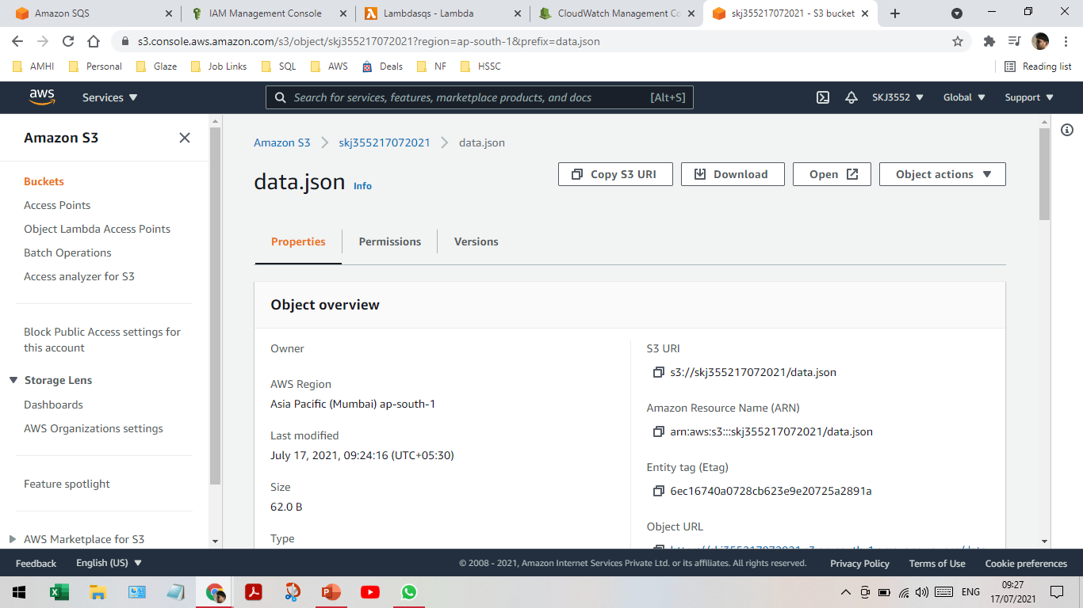

Slide 8
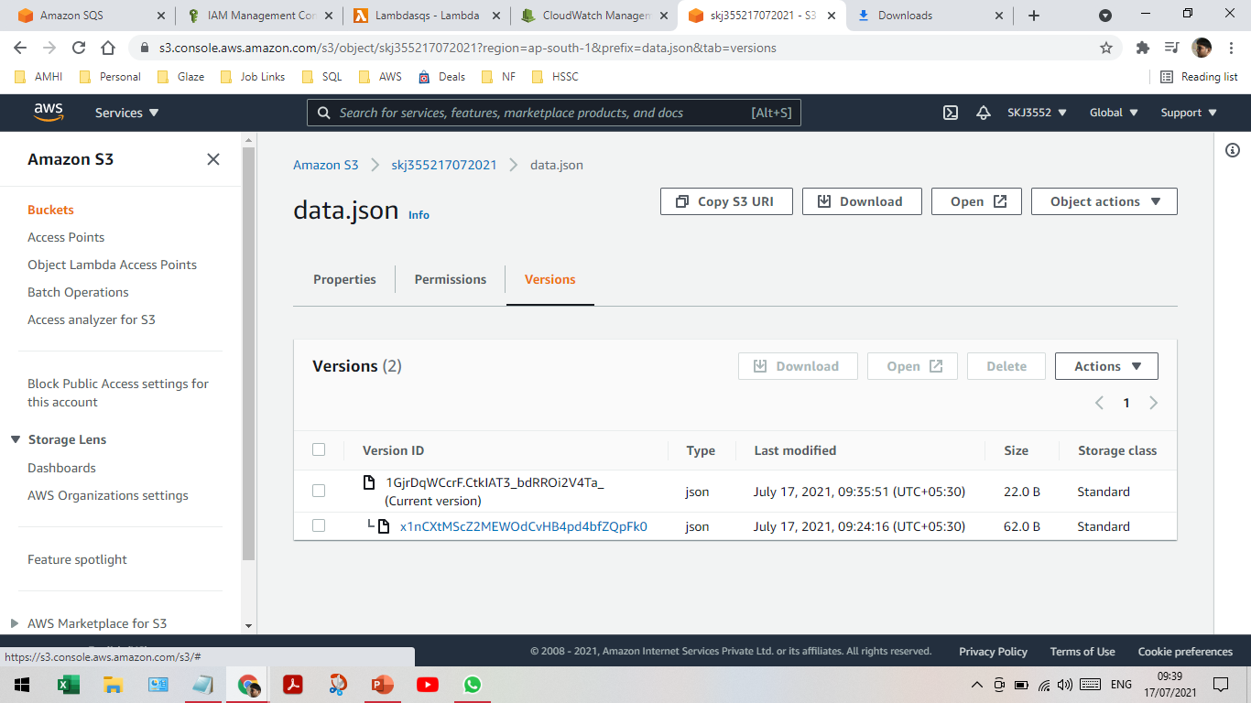

Slide 9
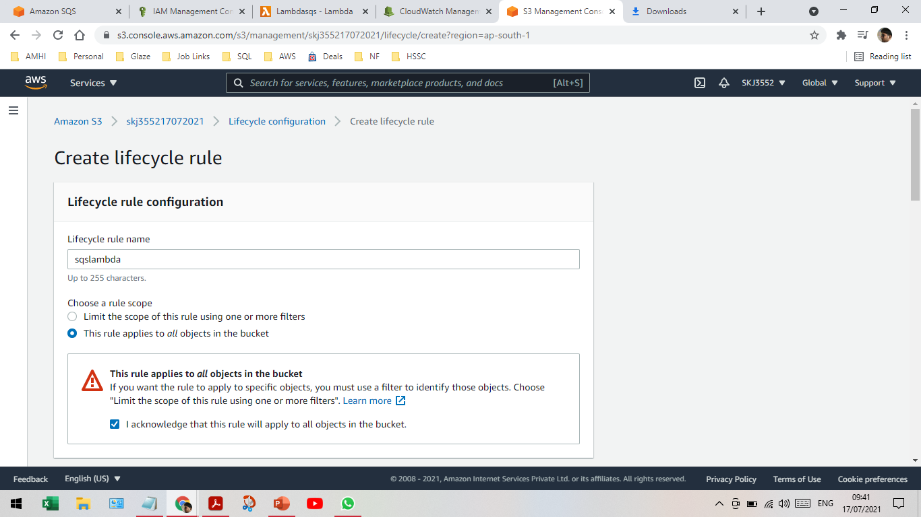
Lifecycle rule of s3 object

Slide 10
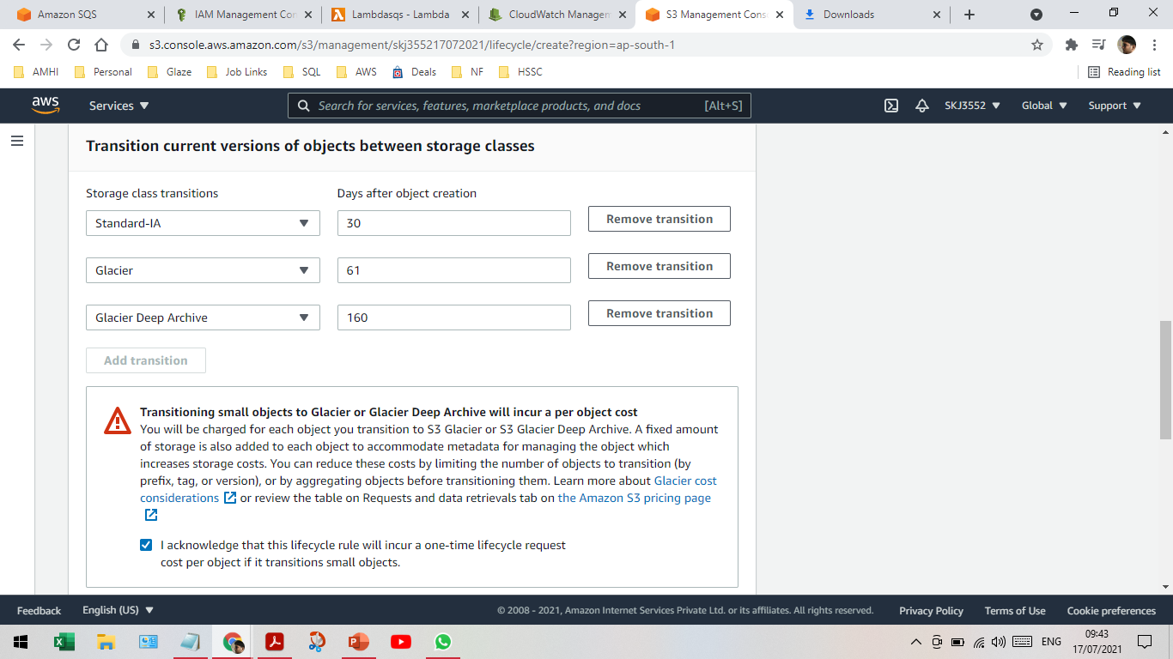
Lifecycle rule of s3 object

Slide 11
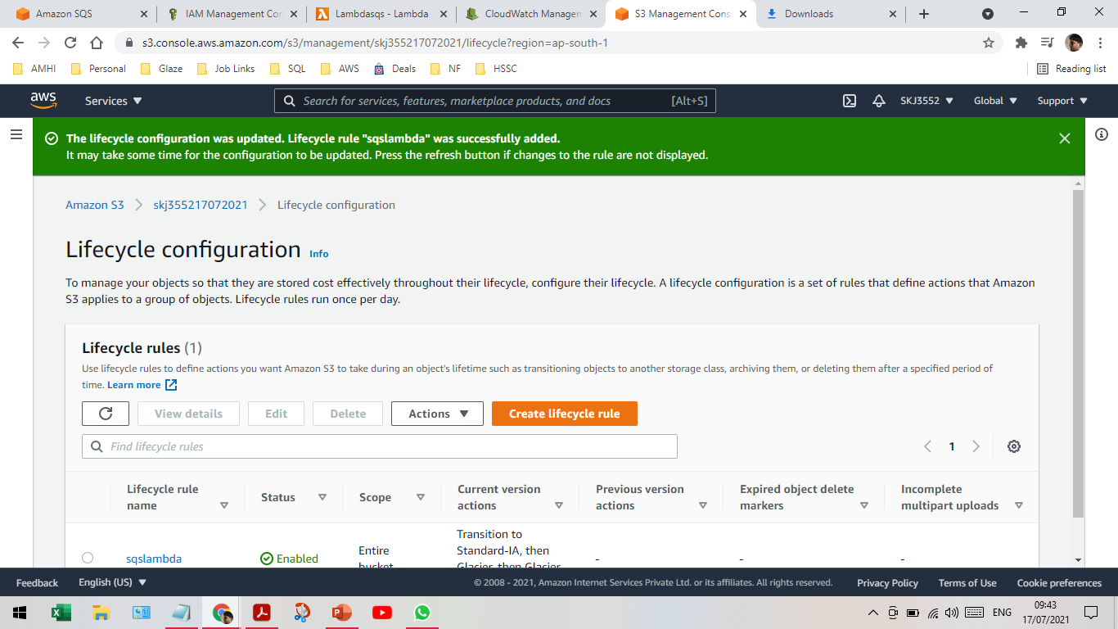
Lifecycle rule of s3 object

